Slide 1
User Interface design
Course Information
Version 2.0
© Maurizio Morisio, Luca Ardito 2024

Slide 2
Or, Usability (NF requirement)

Slide 3
For more
02JSKOV Human Computer Interaction
Prof. Luigi De Russis

Slide 4
UI Design
When human actors are involved, designing the User Interface (often Graphical User Interface) is a key design choice
We assume that RE activity has been completed
(in practice RE and UI design may overlap)

Slide 5
Example
(G) UI
Actor | Physical interface | Logical interface
Human actor | Screen, keyboard | GUI
..

Slide 6
Key message #1
Experimentation
The UI should be experimented with the end users

Slide 7
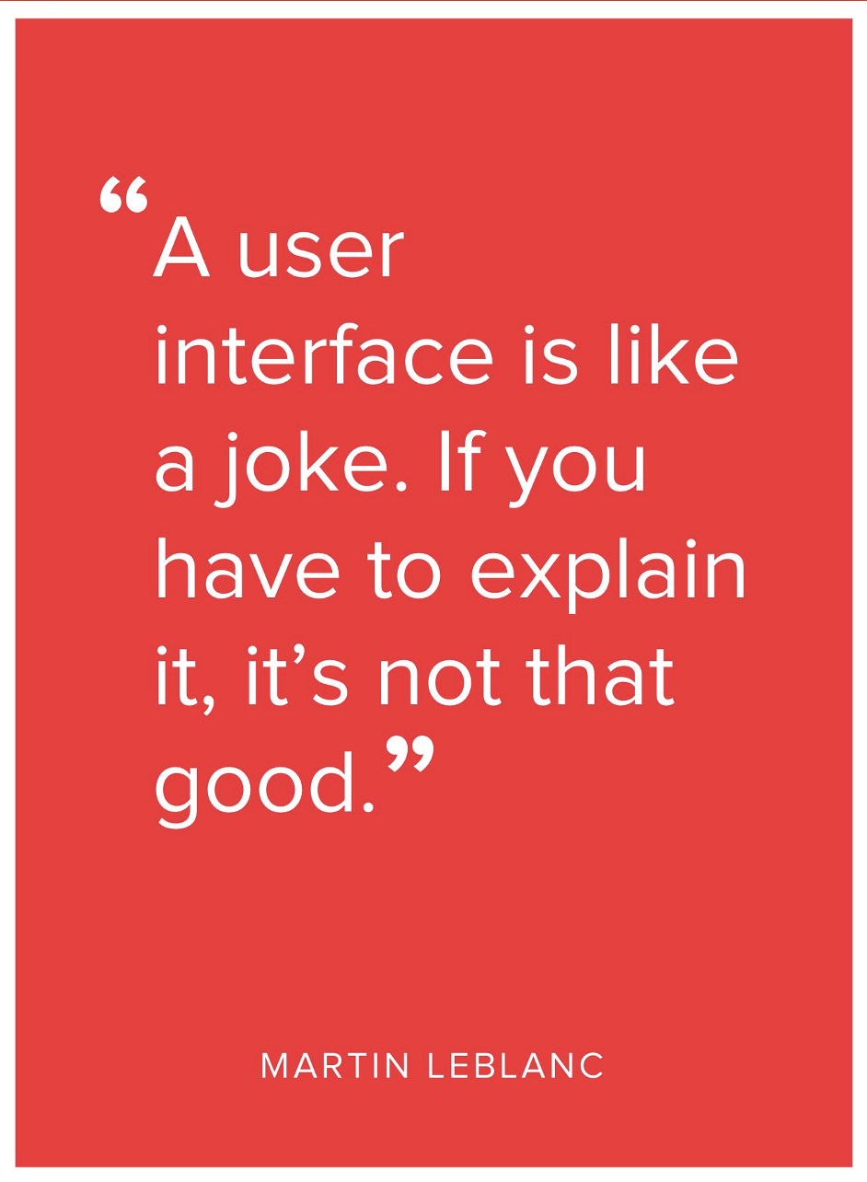
Key message #2

Slide 8
How to
Starting points are
Context diagrams, actors
Functional requirements
Use cases

Slide 9
The process - phases
developers
Development
deployment
retirement
release
users
Operation
Maintenance
developers
time
months
years
Notes:
Development: first time the system is developed
Pic tries to maintain scale of time. Maintenance is long and costs more than initial development. Budget of companies goes in operation ,mostly
Maintenance, we will not do it – it can be seen as a sequence of smaller developments
Maintenance starts a bit after operation starts, and stops a bit before dismissal
Devel and maint made by developers
Operation made by user

Slide 10
The process - development
Requirement inspection
Requirement engineering
Requirement
document
Architecture and design
Design inspection
Test, code inspection
Design
document
Implementation
Software
system
Configuration management
Project management

Slide 11
Context
Software types
Embedded software
Mass market / consumer software
Enterprise software

Slide 12
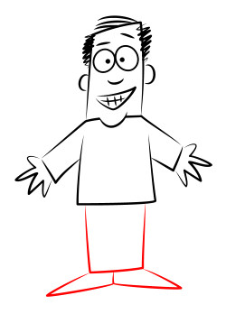
Context
SYSTEM
interaction
interface

Slide 13
Interaction
interface
Input from user
SYSTEM
Output from system

Slide 14
Interaction means
User |  | System
Sight |  | Screen, printer, glasses.
Hearing |  | Noise, music, voice synthesis
Touch |  | Glove
Hands |  | Keyboard, mouse, touchscreen, touchpad, glove
Voice |  | Voice recognition
Eyes |  | Eye tracking
Position, gesture |  | Gesture recognition
Notes:
Nintendo wii or MS KINECT for gesture

Slide 15
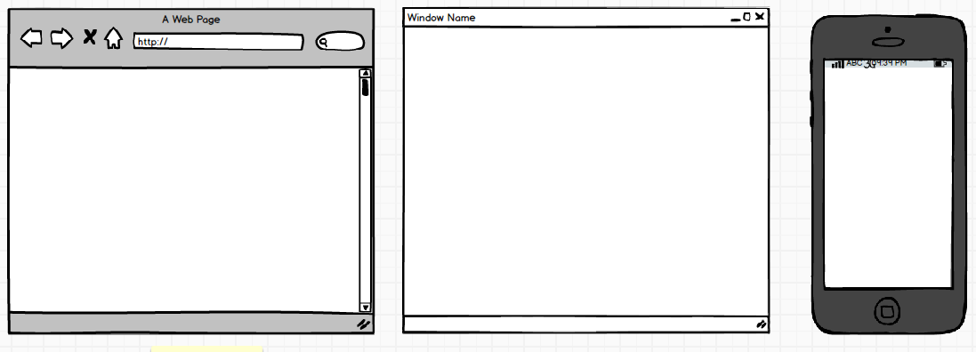
Context
One application, many UIs
Web
Desktop
Mobile

Slide 16
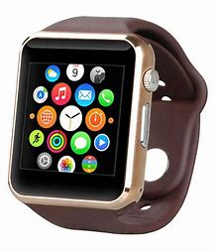
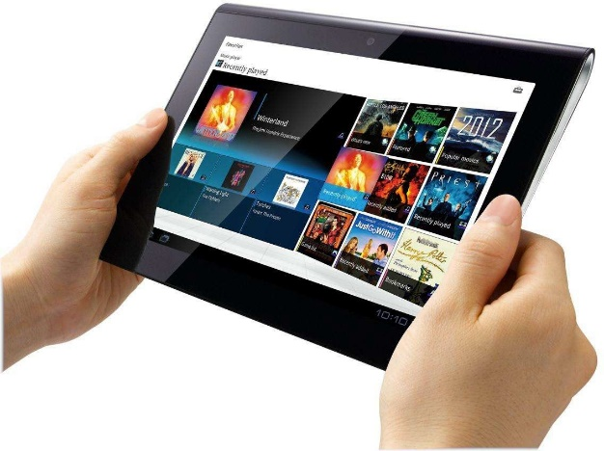
Context
One application, many UIs
Tablet
Smartwatch

Slide 17
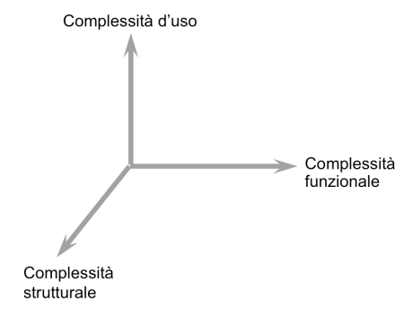
Principles - simplicity
Complexity of usage
Complexity of
functions
Complexity of structure
Notes:
Avoid accidental complexity

Slide 18
Simplicity
UI should be as simple, as allowed by complexity of structure, of functionality

Slide 19
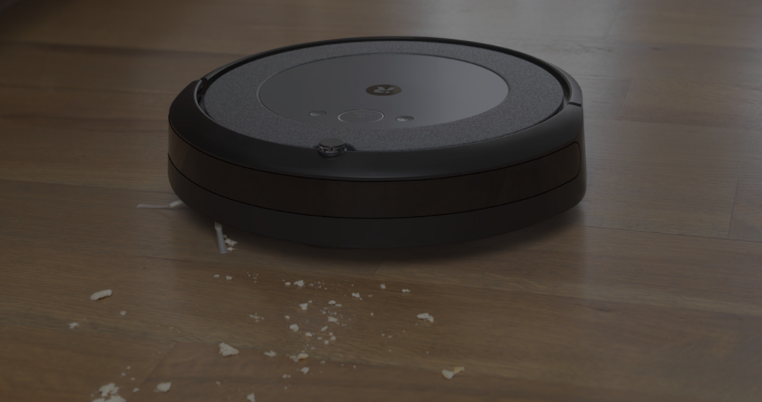
Ex RVC - basic
Functions: clean, (map)
Interaction
Option1: 1 button
press 3 seconds: on, press 5 seconds: off, press 3 times quickly: clean
Option2: 2 buttons + 4 inch display
On off, clean. Display shows status
Option3: 3 buttons
On off, clean, map
Option4: App on smartphone, several windows
Which is best option?

Slide 20
Ex RVC - advanced
Functions:
Manage multiple spaces (many rooms, many houses)
Plan cleaning (every Tuesday at 6am do room1, wed at 7 am room 2)
Show status (where robot is, bag is full, .. )
Show maps collected
Structure
One charging station per space
UI
Smartphone app with several windows and commands

Slide 21
Ex RVC
Basic vs advanced
More functions, more structure, more complex UI
Basic
Given set of functions (ex basic version) UI can be more or less simple
Keep it simple!!

Slide 22
Personas
Identify and describe typical users
A persona is a subset of actor (see later)
Ex persona1: female, middle age, professional, high income, married with children
Ex persona2: male, young, student, low income, not married

Slide 23
Personas
For each persona describe life scenarios
Persona1, work day: wake up, breakfast, drive children to school, drive to office ...
Persona1, week end day: ...
For each persona /scenario identify possible interaction with application/object

Slide 24
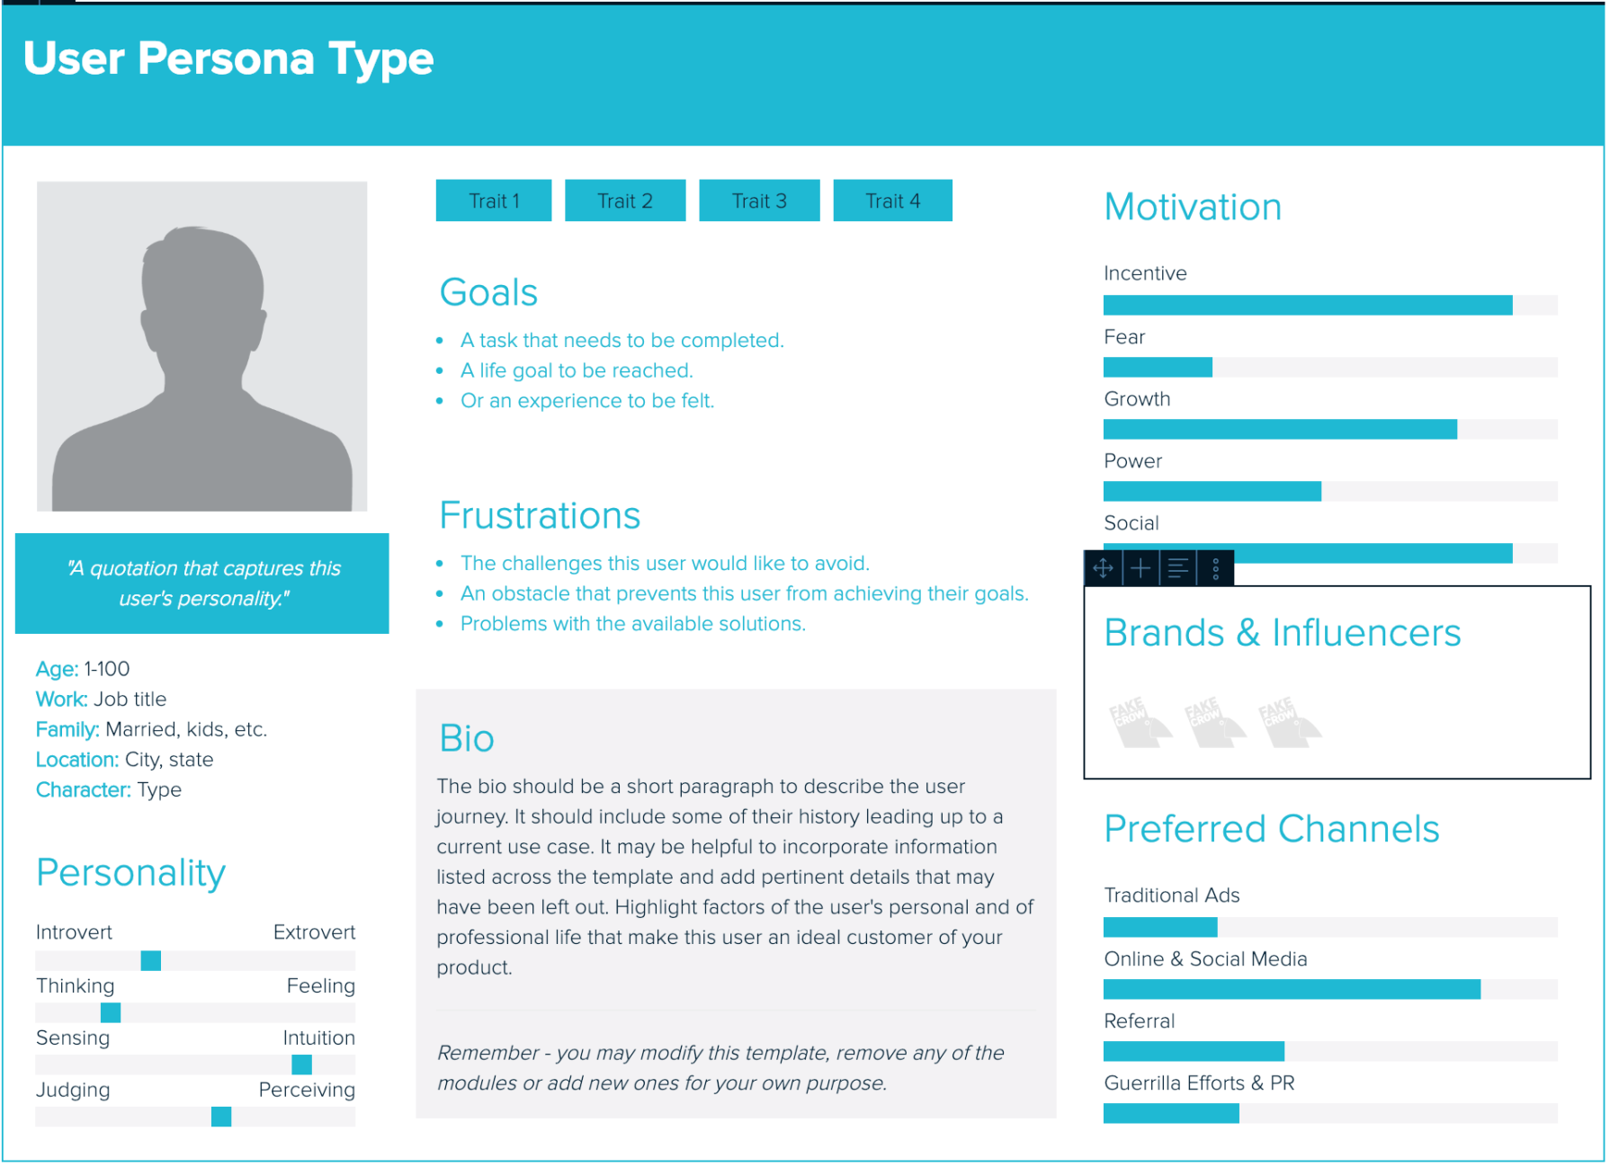
Example

Slide 25
Stories
Help to understand interactions
Are a cheap way to illustrate design solution from user’s (persona’s) point of view
Tell user’s goals, motivations and actions

Slide 26
Stories
“What should this product do?”
“How would user behave in this context?”
“What if...?”

Slide 27
Stories
Without your solution, present-based
Focus is set on current practices that illustrate ‘state of the art’ and the problem context
With your solution, future-based
Focus on how problems could be addressed (without diving into details and jargon)

Slide 28
Stories
In what settings will the product be used?
Is the persona frequently interrupted?
With what other products will it be used?
What primary activities does the persona need to perform to meet her goals?
What is the expected end result of using the product?

Slide 29
Example: EZGas
Persona 1: high-income professional, male, married, with children, 45 yo
Story: need to visit a client, morning in rush hour, is late, need to find closest open station, no matter what price
Persona 2: doctor, female, 35
Story: back from a long hospital shift, 2 am, alone, need to find the safest place to refuel

Slide 30
Example: EZGas - 2
Persona 3: student, male, 22, low income
Story: borrowed car from a friend, need to find the cheapest place to refuel
Persona 4: young professional female, 30, is very sensitive about pollution and greenhouse emissions, has a hybrid car
Story: commutes home every weekend, needs to find a more sustainable fuel provider
Persona 5: similar to 4, has a fully electric car
Story: needs to find a charging station

Slide 31
In summary
Personas + stories help to find
Functionalities to be offered to satisfy categories of needs (profiles / personas)
(functionalities NOT to be offered)
Interaction modalities
Ex mobile usage on car vs desktop usage at home

Slide 32
Approaches
Ergonomy
Safety, adaptability, comfort, usability,...
Emotional design
Beyond ergonomy, the interaction (object) should cause positive emotions in the user
User eXperience (UX)
Usability + feelings + emotions + values
Notes:
Who invented the GUI style iteraction? No bill gates, no steve jobs
Mouse: doug Englebart – SRI
Xerox PARC (alan Kay and others) - STAR workstation Gipsy editor

Slide 33
Approaches
Transparent technology
No emphasis on technology
Feedback, user centered design
No decision based on personal opinions, but feedback from real users

Slide 34
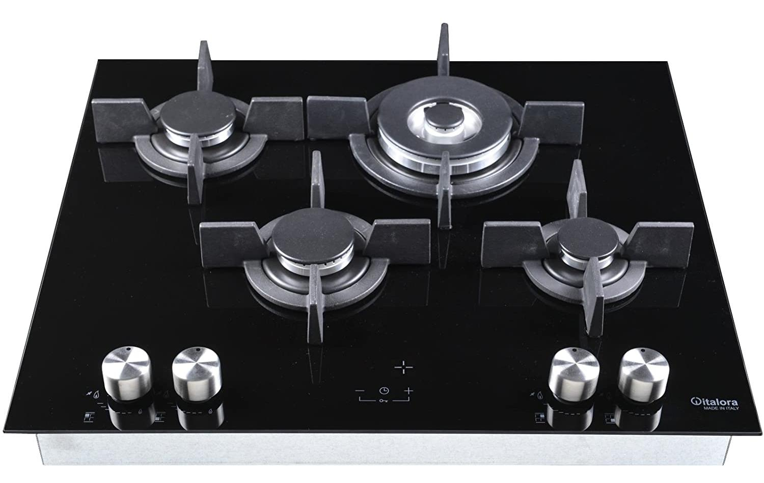
Cooker

Slide 35
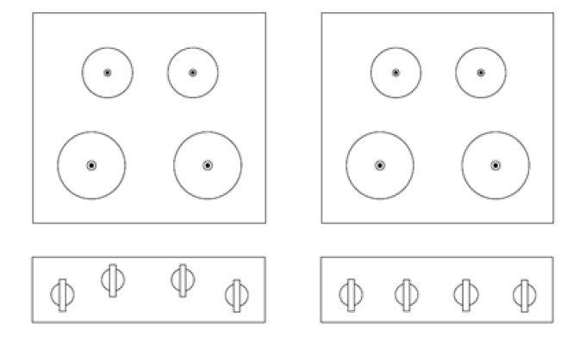
Cooker UI

Slide 36
Cooker UI

Slide 37
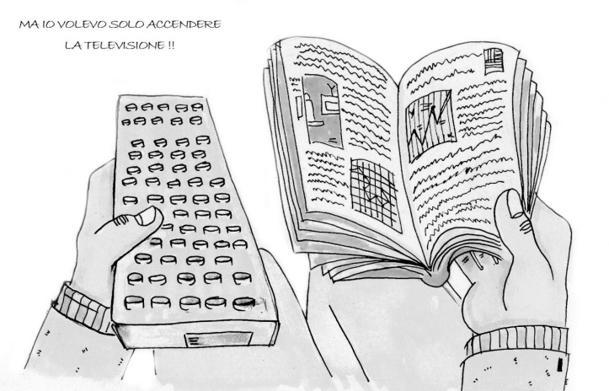
And, for turning the TV on?

Slide 38
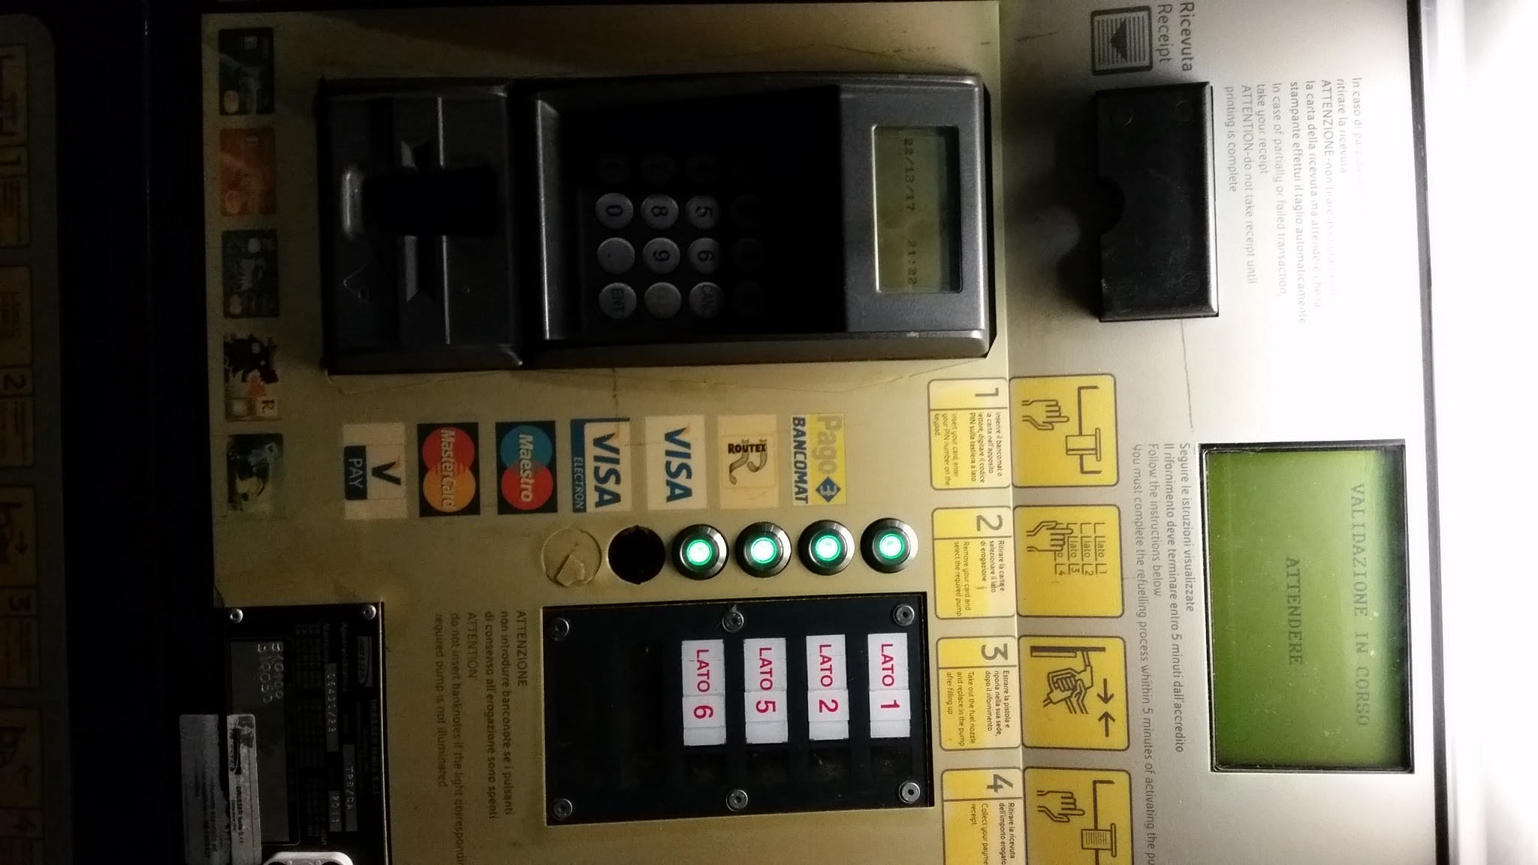
Two screens and two keyboards

Slide 39
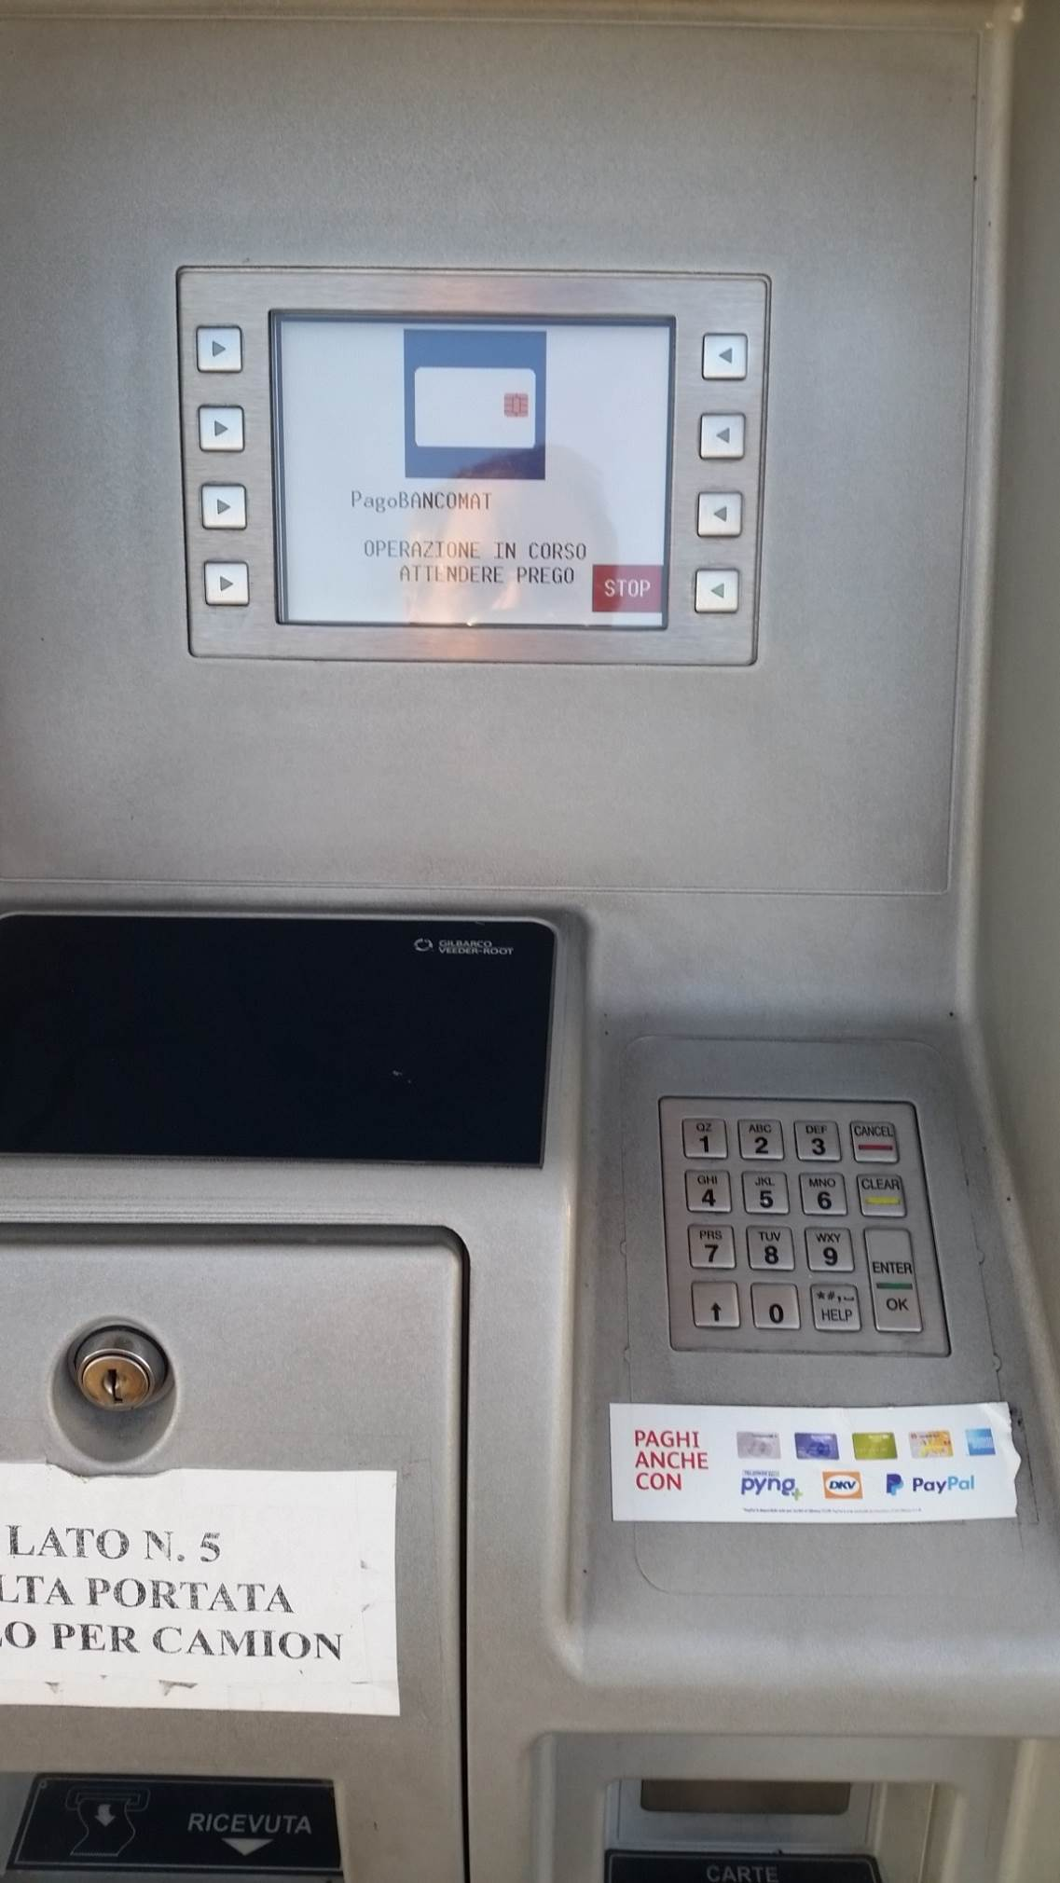
One screen
Keyboard + touchscreen
Notes:
Exemple of structural complexity that surfaces (the POS is ‘added’ to the UI)

Slide 40
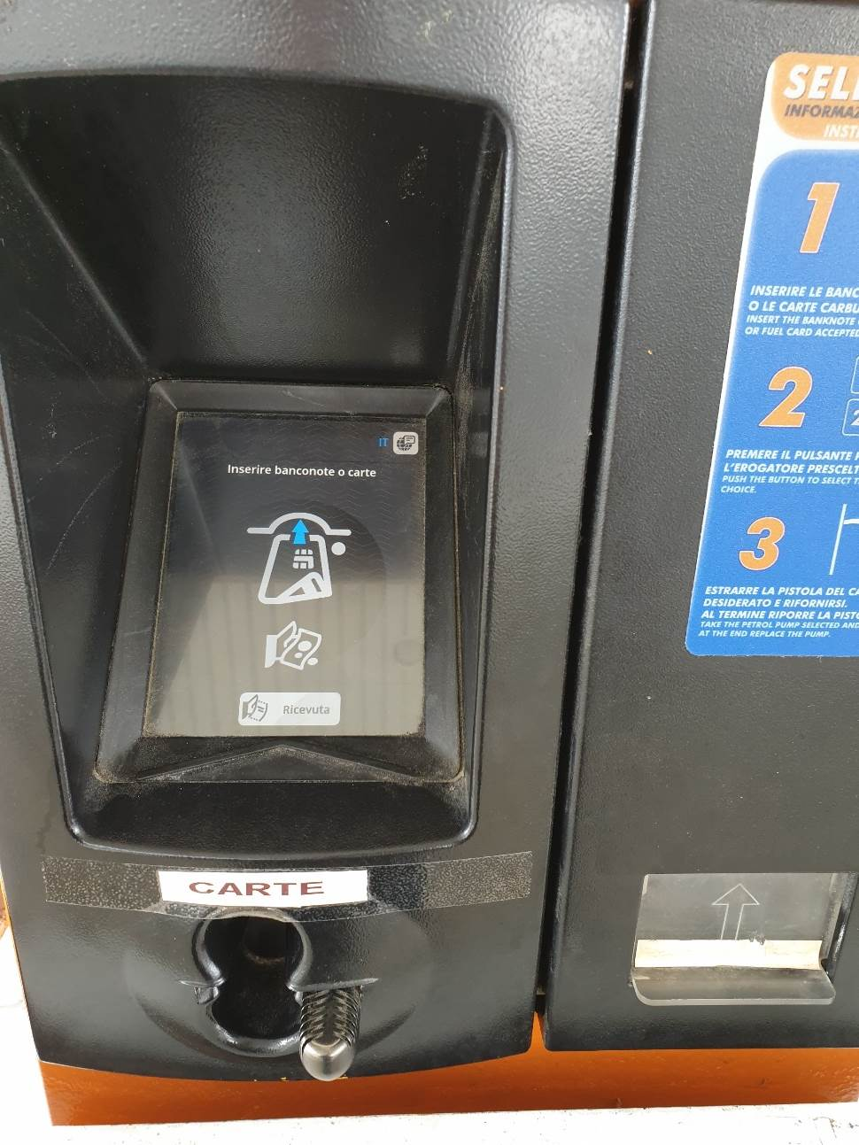
And finally…
ONE SINGLE interaction point

Slide 41
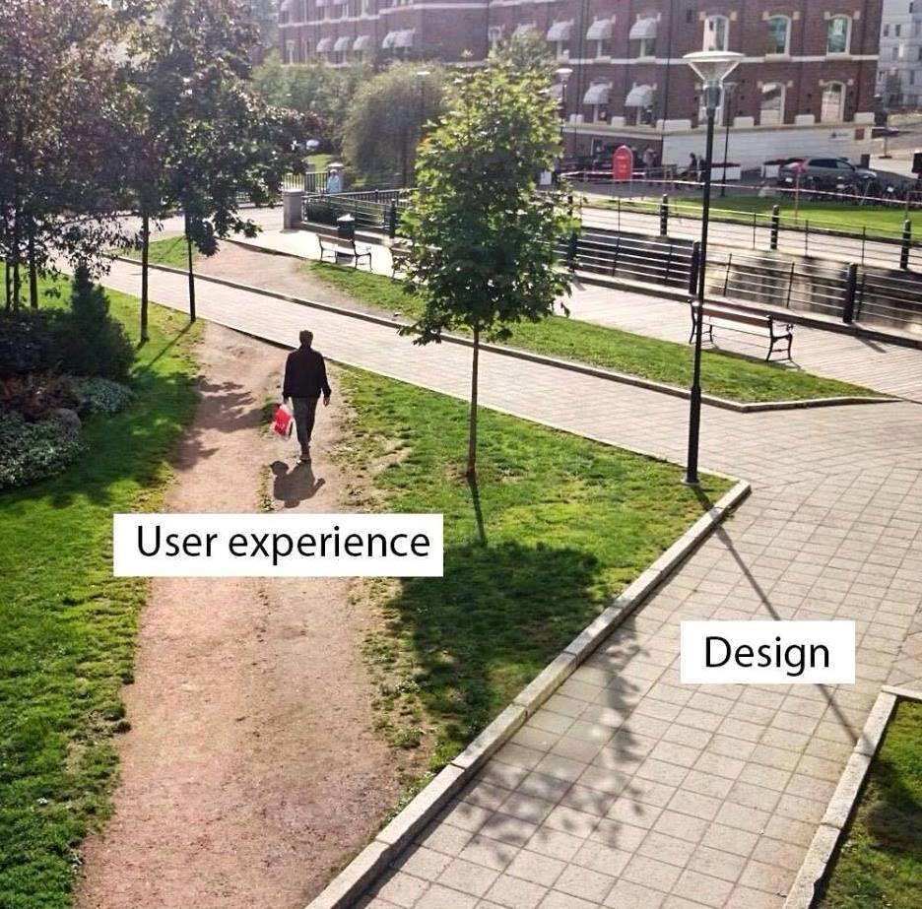

Slide 42



Slide 43
User centered design
Context: mass market product

Slide 44
UCD process - techniques
Activity# | Activity | Techniques
1 | Identify the users | Context diagram, personas / actors
2 | Define requirements | Use cases, scenarios, functional requirements
3 | Define system and interactions | Prototypes
4 | In lab tests | Ethnographics, Interviews
5 | In field tests | A/B testing Measurements

Slide 45
Prototypes
Low fidelity
Paper / pencil, sketches, post its
High fidelity
Computer executable mock ups
Aka Powerpoint
Aka Balsamiq, Figma, ..
Actual GUIS
GUI Builders:
WindowBuilder (Eclipse, Java)
NetBeans Gui Builder (Net Beans)

Slide 46
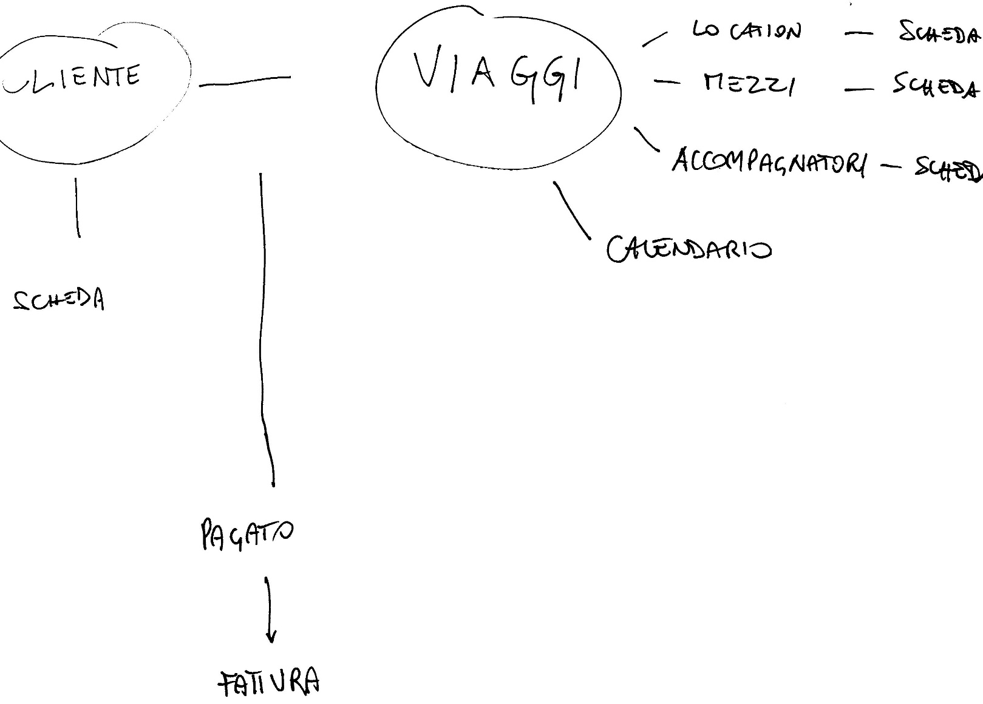
Sketch

Slide 47
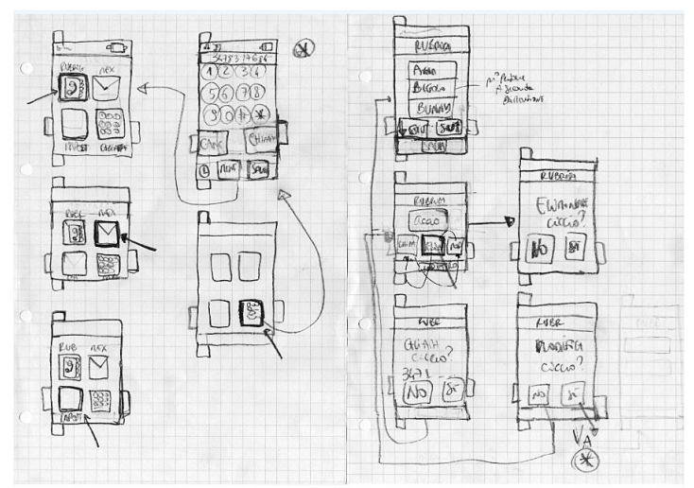
Sketch / storyboard

Slide 48
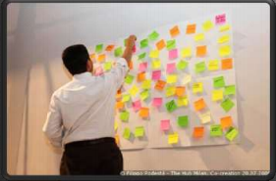
Sketch

Slide 49
Feedback – low fi prototype
Cognitive / ergonomy experts apply checklists / experience to identify possible issues

Slide 50
Feed back – hi fi prototype
Selected users use the prototype in a lab
Feedback via
Ethnographics
Interviews
Focus group

Slide 51
Ethnographics
End users perform their usual activities, using prototype
Researcher(s) observe(s) the behaviour of end users, and especially interaction with prototype
Researcher tries to be invisible as much as possible to avoid modify behaviour of users

Slide 52
Interviews
End users use prototype
After use, (a subset of users) is interviewed
Interview = set of predefined questions, with open or closed answers, about the prototype
Ex: questionnaire at end of Polito course

Slide 53
Focus group
Users use prototype
After use, they gather in a meeting, lead by a moderator
Moderator invites users to express their opinions, ideas, suggestions
Scribe takes notes, moderator draws conclusions

Slide 54
Feedback, final system
Define and collect measures about
Usage of system (time spent on different pages / part of pages, errors)
Effect of system, conversion rate (ex rate from browse to purchase)

Slide 55
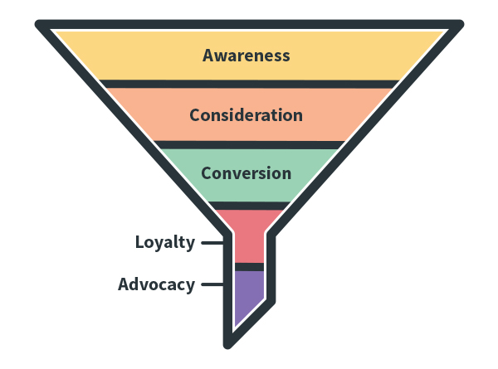
Marketing funnel

Slide 56
Conversion rate
In general
From awareness of product / service
To customers purchasing
On ecommerce website
From number of landing on web page per day by unique visitors
To number of purchases

Slide 57
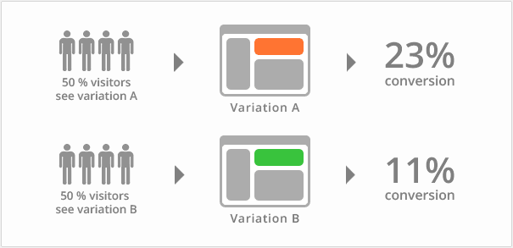
Feedback
A/B test

Slide 58
Designing the GUI
Technical elements
Usability guidelines

Slide 59
Technical elements

Slide 60
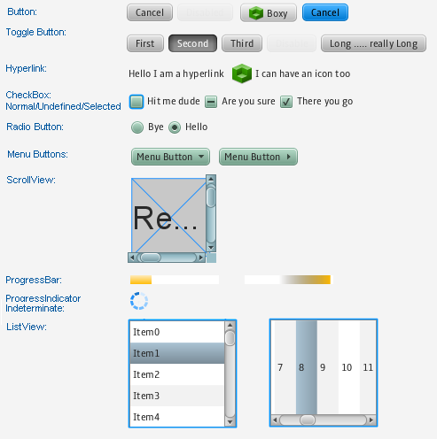
Java

Slide 61
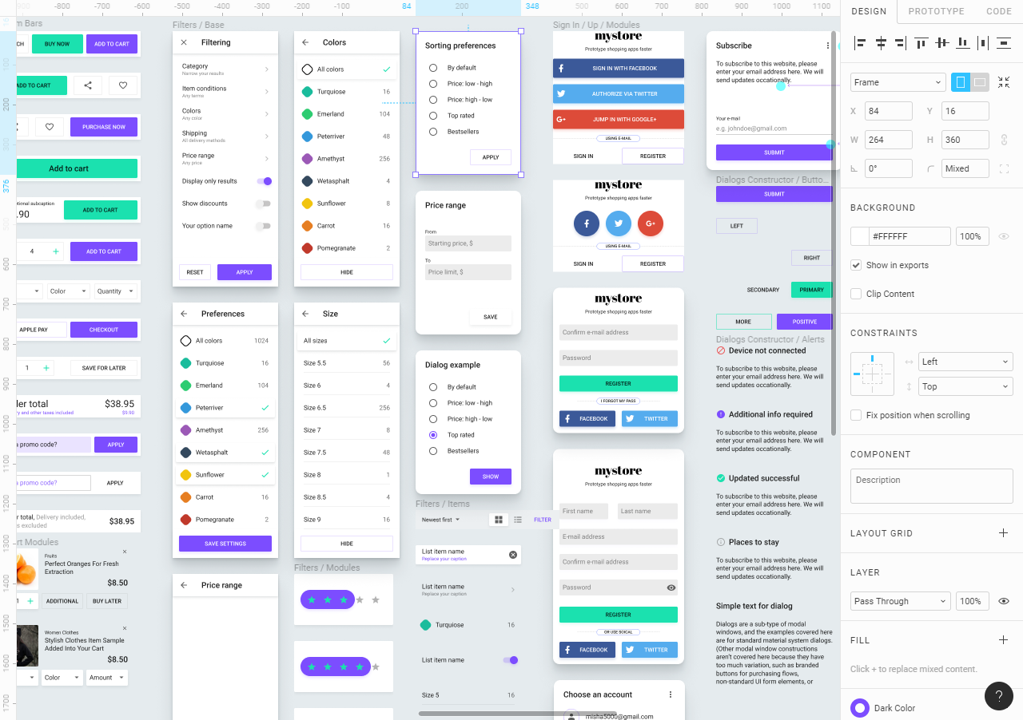
Android

Slide 62
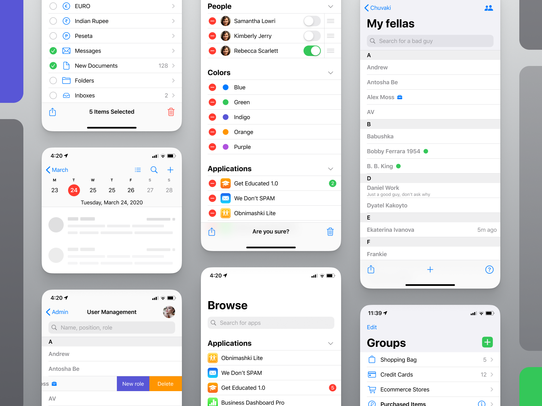
iOS

Slide 63
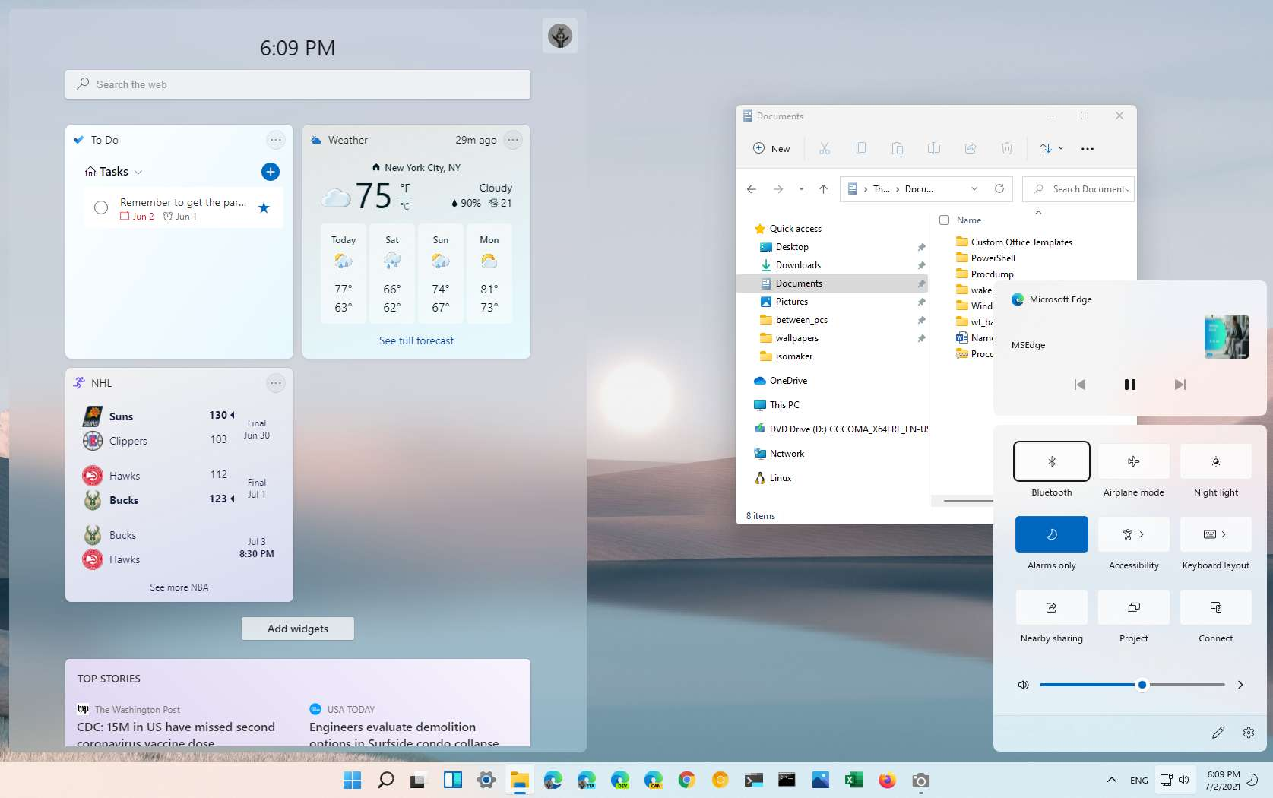
Windows

Slide 64
Issue
Portability of the GUI
Redevelop GUI for each environment
Cross platform compilers
Ex Xamarin, Cordova, Flutter, ..
Cross platform GUI
Browser

Slide 65
Usability guidelines
Have same style and format in all pages
Do not ask same info twice
Give feedback
When button clicked, when text inserted, when processing
Make interactive objects obvious
Large buttons, blinking, ..

Slide 66
Usability guidelines
Consider default values in input fields
Clear success / error messages
Show clearly navigation hierarchy
Use breadcrump trails

Slide 67
Usability guidelines
Simplicity /readability
Min number of pages
Min number of colors / fonts
Font min size
N elements in page
N pages
Use conventions
Logo at top left
Click on logo brings to home
Links change color when mouse hovers
Next / back always in the same place

Slide 68
Summary
In mass market products User interaction is key
User centered design
Focuses on user feedback
Using several techniques in a defined process
Key message: UI design must be validated with users
Never assume you did it right

